Slide 1
Computer Networks: Unit 3: DLL
Prof. Swarnalata Bollavarapu
Contact: swarnalata.b@nmims.edu

Slide 2
Contents
Data link layer design issues
error detection and correction
elementary data link protocols
Sliding Window Protocols
Example of Data Link Protocol: HDLC
Ref Book: Tanenbaum, “Computer Networks”

Slide 3
Introduction

Slide 4
Introduction
There are certain limitations that have important implications for the efficiency of the data transfer.
What do you think are the limitations?
The protocols used for communications must take all these factors into consideration.

Slide 5
Data Link Layer Goals/design issues
Providing a well-defined service interface to the network layer.
Dealing with transmission errors.
Regulating the flow of data so that slow receivers are not swamped by fast senders.

Slide 6
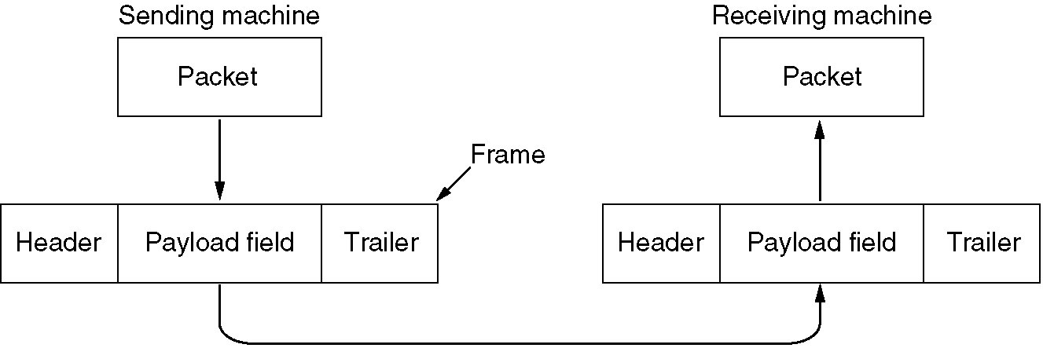
Data Link Layer Design issues
To accomplish goals data link layer (DLL) takes the packets it gets from network layer
Encapsulates them into frames for transmission
Frame contains frame header, a payload field for holding the packet and Trailer

Slide 7
Data Link Layer Design issues
Services provided to the network layer
Framing
Error control
Flow control

Slide 8
Services Provided to Network Layer
Transmitting data from network layer of source machine to network layer of destination machine
Process at network layer on source machine gives bits to DLL to transmit it to the destination
The job of the DLL is to transmit the bits to the destination machine so that they can be handed over to the network layer there.

Slide 9
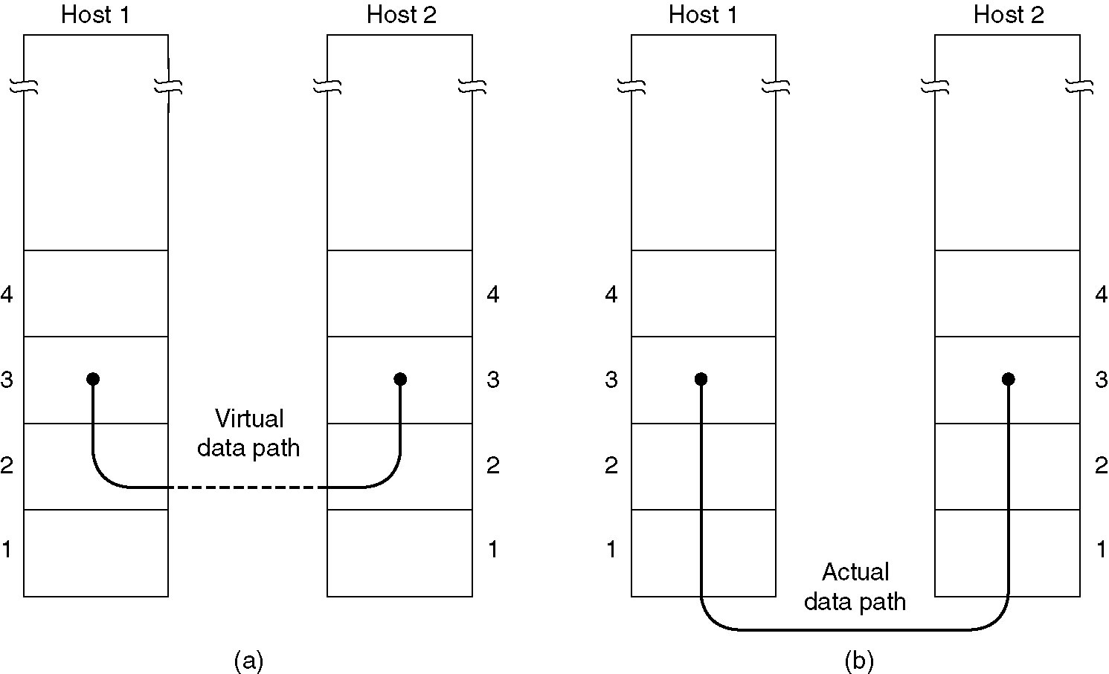
Services Provided to Network Layer

Slide 10
Services Provided to Network Layer
The data link layer offers many services most commonly provided are :
Unacknowledged connectionless service
Acknowledged connectionless service
Acknowledged connection – oriented service

Slide 11
Unacknowledged connectionless service
Source machine sends independent frames to destination
Destination do not acknowledge
No logical connection established
If a frame is lost due to noise, no attempt is made by DLL to recover loss
Suitable for services where error rates are less so that recovery is left to higher layers
Example Voice: late data worse than bad data
Most LANs uses unacknowledged connectionless service

Slide 12
Acknowledged connectionless service
No logical connection established
Each frame received is acknowledged to improve reliability
Sender comes to know whether frames are received or not
If not received within specified time interval frames will be retransmitted
Useful over unreliable channels as wireless systems.

Slide 13
Connection Oriented service
First phase: Connection establishment
Initialize variables and counters to keep track which frames are received and which ones have not
Second phase: actual data transmission frames are transmitted
Third Phase: The connection is released, freeing up the variables ,counters and other resources used to establish connection

Slide 14
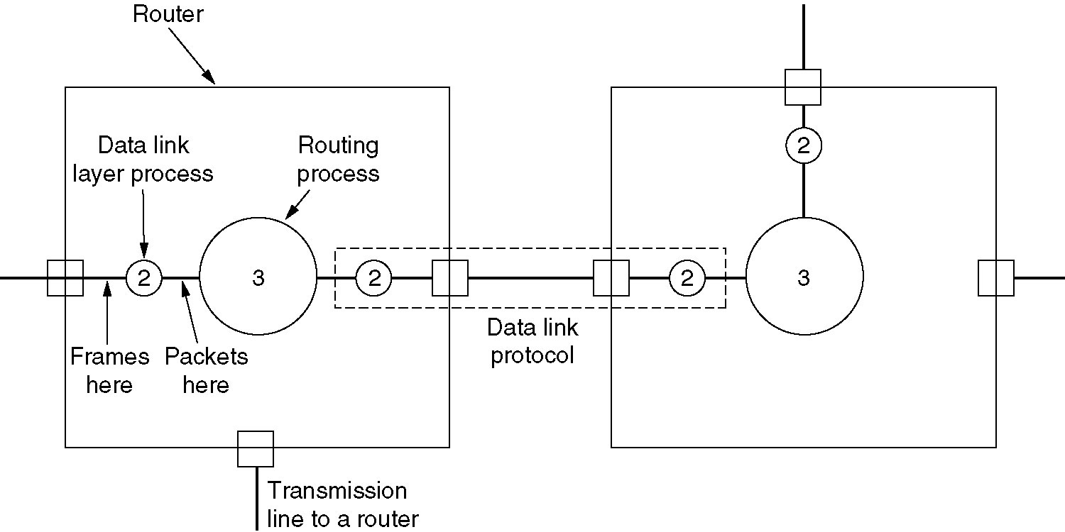
Services Provided to Network Layer (2)
Placement of the data link protocol.

Slide 15
Framing
Provides service to network layer
Uses service of physical layer to provide service to network layer
Physical layer accepts bit stream and deliver it to destination
Bits cannot be error free
Number of bits received can be equal to, less than or greater than number of bits transmitted and they may have different values
It is responsibility of DLL to detect error and correct error

Slide 16
Framing
DLL break bit stream into frames.
Compute checksum for each frame
Checksum is appended in frame.
When frame is received again checksum is computed.
If new checksum and old checksum in header matches frame is received correctly without error.
If differs than DLL knows that error has occurred and takes necessary steps

Slide 17
Framing
Breaking bit stream into frames is difficult
One way : insert time gaps between frames
Like space between words
but networks rarely guarantee about timings, some different method is required.

Slide 18
Framing
Four methods are there to break bit stream into frames:
Character count
Flag bytes with byte stuffing
Starting and ending flags with bit stuffing
Physical layer coding violations

Slide 19
Framing
First method uses character count field in the header
That tells total number of characters in frame
When frame is arrived at destination DLL at destination sees character count in header
From character count it knows how many characters follow and hence where the end of frame is.

Slide 20
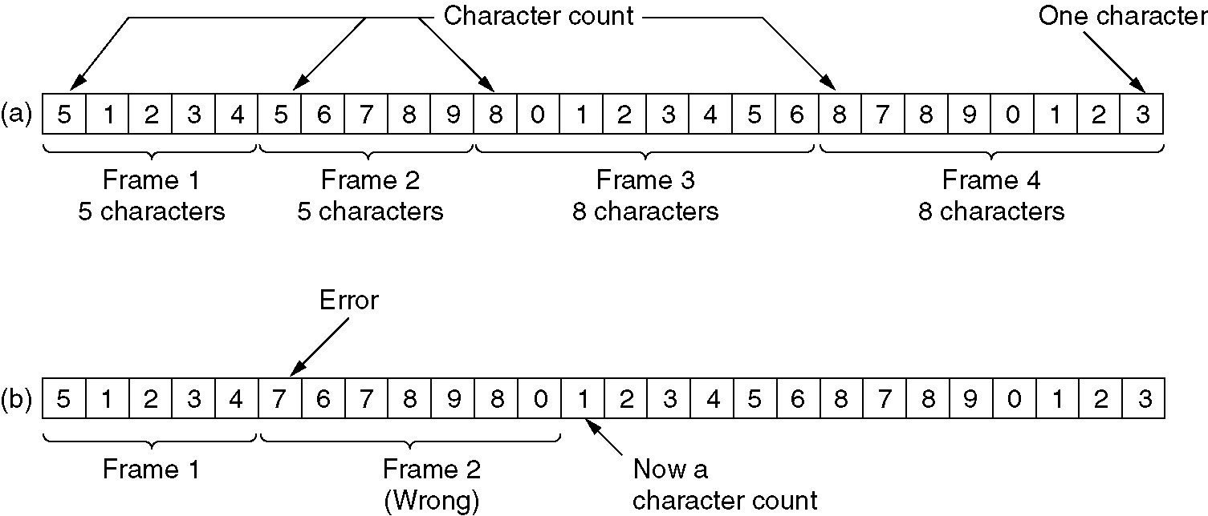
Disadvantage of character count method
Count can be garbled by a transmission error
Destination will get out of sync and will unable to locate the start of next frame
Even if checksum is wrong destination knows that frame is bad, but how destination will tell which frame to be retransmitted to sender

Slide 21
Framing
The second method is to have a solution of resynchronization after error has occurred
Each frame will have start and end with special bytes called a flag bytes
If receiver loses sync it can just search for the flag byte to find the end of the current frame
Two consecutive flag bytes indicate the end of one frame and starting of another

Slide 22
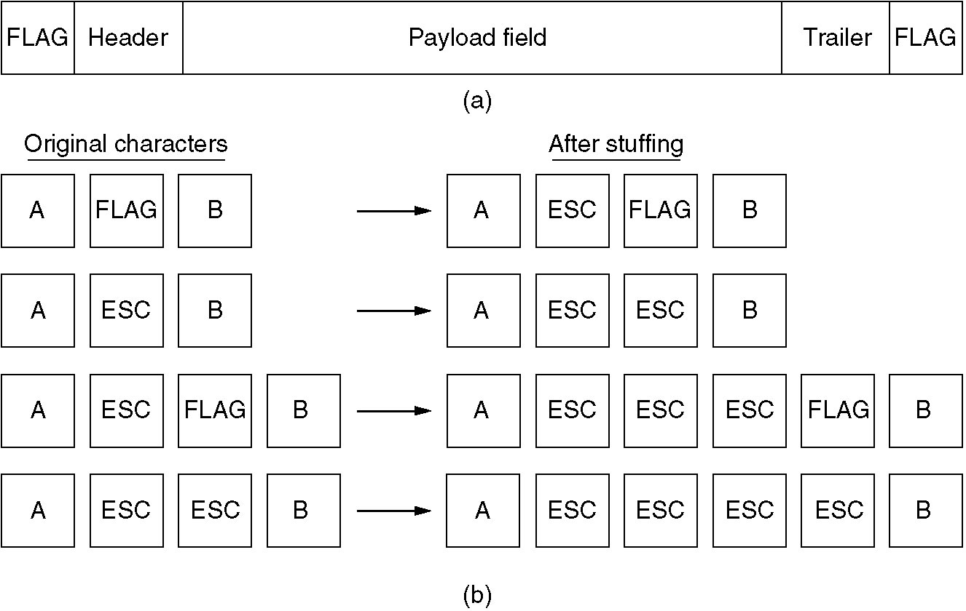
Framing

Slide 23
Framing
Problem: it may easily happen that the flag byte’s bit pattern appears in data
Solution: sender’s data link layer insert a special escape byte just before each “accidental” flag byte in the data.
The DLL at receiving side removes the escape byte before the data are given to the network layer
The technique is called byte stuffing or character stuffing

Slide 24
Framing
Next technique is begin and end each frame with special bit pattern ,01111110
Whenever sender’s data link layer encounters five consecutive 1s in the data it automatically stuffs a 0 bit into the outgoing bit stream
When the receiver sees five consecutive incoming 1 bits followed by a 0 bit it automatically destuffs the 0 bit
If the user’s data contain the flag pattern 01111110 this flag is transmitted as 011111010
Known as bit stuffing

Slide 25
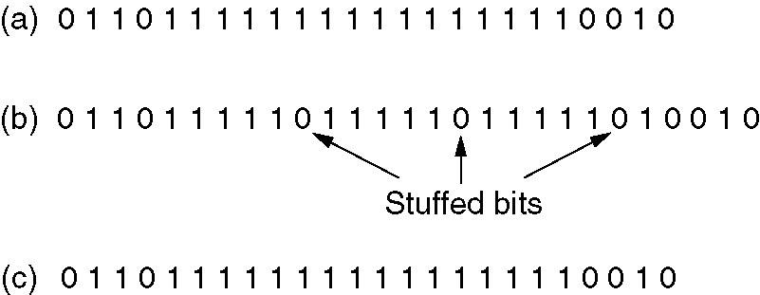
Framing
Bit stuffing
(a) The original data.
(b) The data as they appear on the line.
(c) The data as they are stored in receiver’s memory after destuffing

Slide 26
Error Control
To ensure reliable delivery : provide some feedback to sender
Protocol should be designed in such a way for receiver to send some special control frames to sender
Special control frames include positive or negative ack
If sender receives positive ack, it knows frame has been received correctly
If negative ack then something has gone wrong and frame must be retransmitted
If frame is lost due to hardware problem receiver will do nothing, sender will go on waiting for ack.

Slide 27
Error Control
Solution : timers in DLL
When sender transmits frame it starts timer
The timer is set to expire after an interval long enough for the frame to reach destination, be processed there and time taken for ack to reach back to sender
If timer expires and no ack is received sender will notice some problem and retransmit frame
Problem: Reciever might receive same frame twice
Solution : Give sequence number to each frame

Slide 28
Flow Control
Occurs when sender want to transmit frames faster than receiver can accept them
Occurs when sender is running on fast computer and receiver is running on slow computer
Even if transmission is error free, at certain point of time receiver will be not able to handle frames and start losing it
To prevent this two approaches are there:
Feedback based flow control
Rate based flow control

Slide 29
Flow Control
In feedback based flow control receiver sends back information to sender giving it permission to send more data
For example, when a connection is set up, the receiver might say: ''You may send me n frames now, but after they have been sent, do not send any more until I have told you to continue.'' We will examine the details shortly.
In the second one, rate-based flow control, the protocol has a built-in mechanism that limits the rate at which senders may transmit data, without using feedback from the receiver.

Slide 31
Error Detection and Error Correction
Two basic strategies for dealing with errors:
Error correcting codes
Error detecting codes
Include enough redundant information with each block of data sent , to enable receiver to deduce what the transmitted data must have been – Error correcting codes
Include enough redundancy to allow receiver to deduce that an error has occurred but not which error and request retransmission. – Error Detecting codes
Error correcting codes are also known as forward error correction.

Slide 32
Error Detection and Error Correction
On channels that are highly reliable, such as fiber, it is cheaper to use an error detecting code and just retransmit the occasional block found to be faulty.
However, on channels such as wireless links that make many errors, it is better to add enough redundancy to each block for the receiver to be able to figure out what the original block was, rather than relying on a retransmission, which itself may be in error.

Slide 33
Error Detection and Error Correction
Framework:
add redundant information to a frame to detect or correct errors
At sender:
Add k bits of redundant data to a m bit message
K is derived from orginal message through some algorithm
At receiver: reapply same algorithm as sender to detect errors, take corrective action if necessary

Slide 34
Recap
Goals of DLL
Services provided by DLL/Design issues of DLL
Types of transmission errors
Error detection and correction
Basic framework

Slide 35
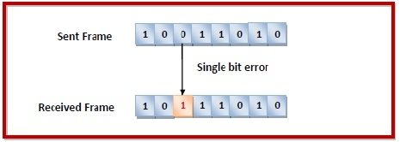
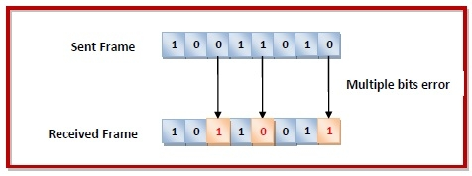
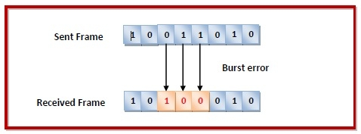
Types of transmission errors

Slide 36
Error Detection
Wireless transmission : more errors : requires error correcting codes rather than retransmission
Copper wire : less errors: requires error detecting codes and initiate retransmission

Slide 37
Error Detection techniques
Parity check
Checksum
Cyclic Redundancy Check (CRC)

Slide 38
Error Detection
Parity Check:
The parity check is done by adding an extra bit, called parity bit to the data to make a number of 1s either even in case of even parity or odd in case of odd parity.
While creating a frame, the sender counts the number of 1s in it and adds the parity bit in the following way
In case of even parity: If a number of 1s is even then parity bit value is 0. If the number of 1s is odd then parity bit value is 1.
In case of odd parity: If a number of 1s is odd then parity bit value is 0. If a number of 1s is even then parity bit value is 1.
On receiving a frame, the receiver counts the number of 1s in it. In case of even parity check, if the count of 1s is even, the frame is accepted, otherwise, it is rejected.

Slide 39
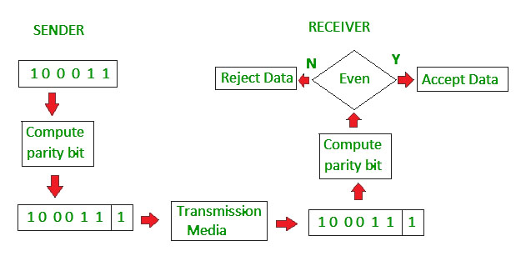
Error Detection
Advantage: detects any single-bit error. Infact, detects odd number of bits

Slide 40
Error Detection
Checksum:
In checksum error detection scheme, the data is divided into k segments each of m bits.
In the sender’s end the segments are added using 1’s complement arithmetic to get the sum. The sum is complemented to get the checksum.
The checksum segment is sent along with the data segments.
At the receiver’s end, all received segments are added using 1’s complement arithmetic to get the sum. The sum is complemented.
If the result is zero, the received data is accepted; otherwise discarded.

Slide 41
Error Detection
Checksum:
Add two binary numbers 11100 and 10101

Slide 42
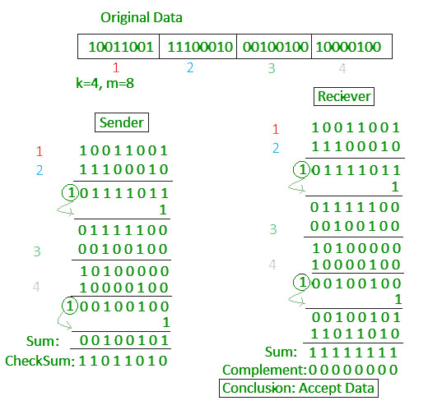
Error Detection
Checksum:

Slide 43
Error Detection
CRC:
Basic idea: treat string of bits as coefficients of a polynomial that uses modulo 2 arithmetic – Ex. 1 0 1 0 0 1 represents x 5 + x 3 + 1
Based on binary division.
In CRC, a sequence of redundant bits, called cyclic redundancy check bits, are appended to the end of data unit so that the resulting data unit becomes exactly divisible by a second, predetermined binary number.
At the destination, the incoming data unit is divided by the same number. If at this step there is no remainder, the data unit is assumed to be correct and is therefore accepted.
A remainder indicates that the data unit has been damaged in transit and therefore must be rejected.

Slide 44
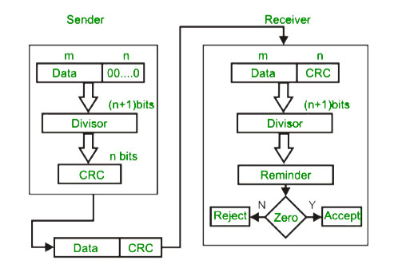
Error Detection
CRC:

Slide 45
Error Detection
Example:
Find the CRC for the frame 100100 transmitted using divisor 1101

Slide 47
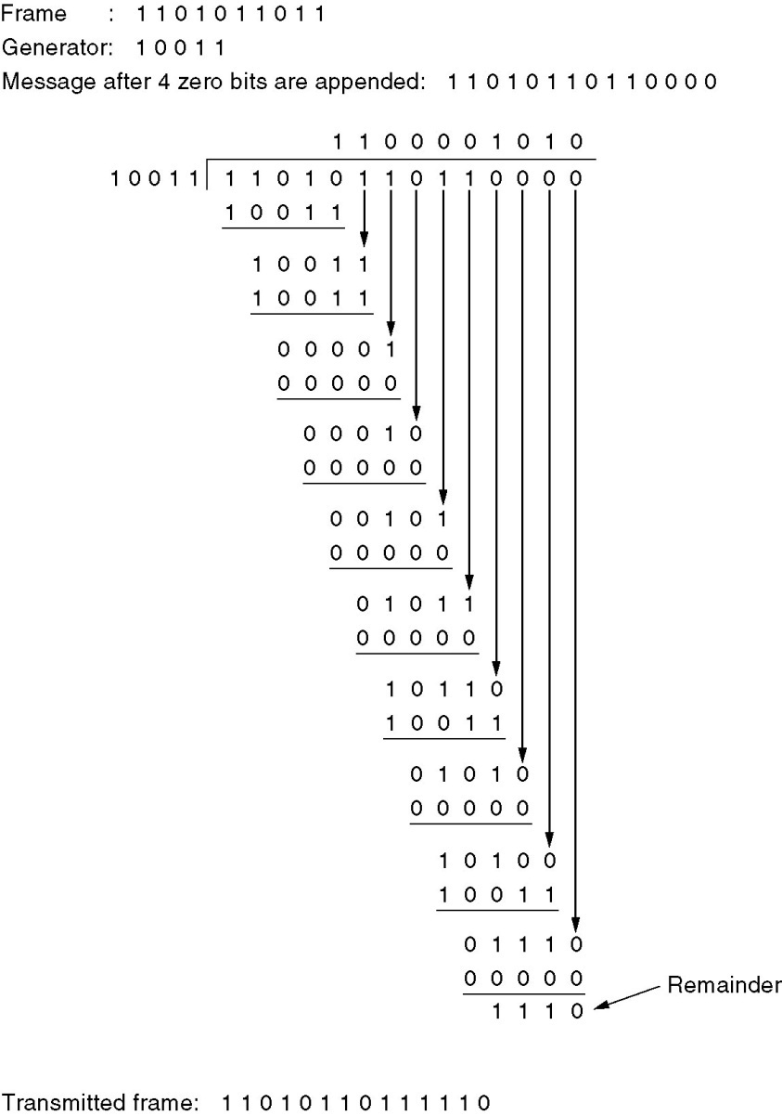

Slide 48
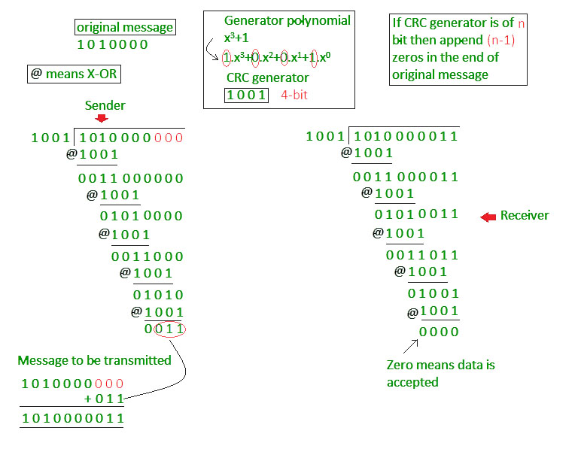
Error Detection
CRC:

Slide 49
Error Correcting Codes
Basics:
All of these codes add redundancy to the information that is sent.
A frame consists of m data (i.e., message) bits and r redundant (i.e. check) bits.
Let the total length of a block be n (i.e., n = m + r), (n,m) code.
An n-bit unit containing data and check bits is referred to as an n bit codeword.
Given any two codewords say, 10001001 and 10110001—
it is possible to determine how many corresponding bits differ. In this case, 3 bits differ. To determine how many bits differ, just XOR the two codewords and count the number of 1 bits in the result.
For example:
10001001
10110001
00111000

Slide 50
Error Correction : Hamming Codes
Given any two codewords say, 10001001 and 10110001—
it is possible to determine how many corresponding bits differ. In this case, 3 bits differ. To determine how many bits differ, just XOR the two codewords and count the number of 1 bits in the result.
10001001
10110001
00111000
The number of bit positions in which two code words differ is called the Hamming distance (Hamming, 1950).
If two code words are a Hamming distance d apart, it will require d single-bit errors to convert one into the other.

Slide 51
Error Correction
In most data transmission applications, all 2^{m} possible data messages are legal, but due to the way the check bits are computed, not all of the 2^{n} possible code words are used.
The error-detecting and error-correcting properties of a block code depend on its Hamming distance.
To detect d errors requires distance d+1 code
To correct d errors requires a distance 2d+1 code

Slide 52
Error Correction
At sender end:
1. calculate the no. of redundant bits
2. Determine the position of the redundant bits
3. Calculate the values of the redundant bits
At receiver end:
1. calculate the no. of redundant bits
2. Determine the position of the redundant bits
3. parity checking
4. error detection or correction

Slide 53
Error Correction
At sender end:
1. calculate the no. of redundant bits
2. Determine the position of the redundant bits
3. Calculate the values of the redundant bits
1. following equation should hold 2r ≥ m+r+1
2. The r redundant bits placed at bit positions of powers of 2, i.e. 1, 2, 4, 8, 16 etc
3. The redundant bits are parity bits, even or odd
Each redundant bit, ri, is calculated as the parity, generally even parity, based upon its bit position. It covers all bit positions whose binary representation includes a 1 in the ith position except the position of ri

Slide 54
Error Correction
At receiver end:
1. calculate the no. of redundant bits
2. Determine the position of the redundant bits
3. parity checking
4. error detection or correction
3. c1 = parity(1, 3, 5, 7, 9, 11 and so on)
c2 = parity(2, 3, 6, 7, 10, 11 and so on)
c3 = parity(4-7, 12-15, 20-23 and so on)
4. The decimal equivalent of the parity bits binary values is calculated. If it is 0, there is no error. Otherwise, the decimal value gives the bit position which has error.

Slide 55
Error Correction
Example: 7-bit hamming code, if v have 4 data bits, 1011

Slide 56
Error Correction
How distance 2?
Consider even parity
Consider number like 1011010 to make even parity 0 will be added hence 10110100
If error occurred and second 0 is converted into 1 that is 11110100
Original number : 10110100 Number with error: 11110100
Perform exclusive OR
10110100
11110100
01000000

Slide 57
Error Correction
As a simple example of an error-correcting code, consider a code with only four valid code words:
0000000000, 0000011111, 1111100000, and 1111111111
This code has a distance 5
it can correct double errors.
If the codeword 0000000111 arrives, the receiver knows that the original must have been 0000011111.
If, however, a triple error changes 0000000000 into 0000000111, the error will not be corrected properly

Slide 58
Error Correction
To use hamming codes for error detection and correction bits of code words are numbered consecutively starting from 1 at the left hand, bit 2 to its immediate side and so on.
The bits that are power of 2 (1,2,4,8,16 etc..) are check bits
The rest(3,5,7,9..) are m data bits
Total number of check bits in entire codeword should be either even or odd.

Slide 59
Calculating the Hamming Code(how to create code word)
Mark all bit positions that are powers of two as parity bits. (positions 1, 2, 4, 8, 16, 32, 64, etc.)
All other bit positions are for the data to be encoded. (positions 3, 5, 6, 7, 9, 10, 11, 12, 13, 14, 15, 17, etc.)
Each parity bit calculates the parity for some of the bits in the code word. The position of the parity bit determines the sequence of bits that it alternately checks and skips.

Slide 60
Calculating the Hamming Code(how to create code word)
Position 1: check 1 bit, skip 1 bit, check 1 bit, skip 1 bit, etc. (1,3,5,7,9,11,13,15,...)
Position 2: check 2 bits, skip 2 bits, check 2 bits, skip 2 bits, etc. (2,3,6,7,10,11,14,15,...)
Position 4: check 4 bits, skip 4 bits, check 4 bits, skip 4 bits, etc. (4,5,6,7,12,13,14,15,20,21,22,23,...)

Slide 61
Calculating the Hamming Code(how to create code word)
Position 8: check 8 bits, skip 8 bits, check 8 bits, skip 8 bits, etc. (8-15,24-31,40-47,...)
Position 16: check 16 bits, skip 16 bits, check 16 bits, skip 16 bits, etc. (16-31,48-63,80-95,...)
Position 32: check 32 bits, skip 32 bits, check 32 bits, skip 32 bits, etc. (32-63,96-127,160-191,...) etc.

Slide 62
Calculating the Hamming Code(how to create code word)
Set a parity bit to 1 if the total number of ones in the positions it checks is odd. Set a parity bit to 0 if the total number of ones in the positions it checks is even.

Slide 63
Calculating the Hamming Code(how to create code word)
Example
A byte of data: 10011010
Create the data word, leaving spaces for the parity bits: _ _ 1 _ 0 0 1 _ 1 0 1 0
Calculate the parity for each parity bit

Slide 64
Calculating the Hamming Code(how to create code word)
Position 1 checks bits 1,3,5,7,9,11: ? _ 1 _ 0 0 1 _ 1 0 1 0. Even parity so set position 1 to a 0: 0 _ 1 _ 0 0 1 _ 1 0 1 0
Position 2 checks bits 2,3,6,7,10,11: 0 ? 1 _ 0 0 1 _ 1 0 1 0. Odd parity so set position 2 to a 1: 0 1 1 _ 0 0 1 _ 1 0 1 0
Position 4 checks bits 4,5,6,7,12: 0 1 1 ? 0 0 1 _ 1 0 1 0. Odd parity so set position 4 to a 1: 0 1 1 1 0 0 1 _ 1 0 1 0
Position 8 checks bits 8,9,10,11,12: 0 1 1 1 0 0 1 ? 1 0 1 0. Even parity so set position 8 to a 0: 0 1 1 1 0 0 1 0 1 0 1 0
Code word: 011100101010

Slide 65
Calculating the Hamming Code(Finding and fixing a bad bit)
code word : 011100101010
Received code word with error : 011100101110
Receiver will calculate which bit was wrong and correct it
Check each check bit
Write down all incorrect parity bits
Here parity bits 2 and 8 are wrong so 2+8=10, 10th bit is a position of wrong bit

Slide 66
Elementary Data Link Layer Protocols (Assumptions)
Machine A wants to send data to machine B using a reliable, connection oriented service
A has infinite amount of data to send and never has to wait for data to be produced
Machines do not crash
Protocol deals with communication errors but not with crashing and rebooting

Slide 67
Elementary Data Link Layer Protocols
Data link layer accepts packet
Encapsulates packets into frame
Add control info(in header) and checksum (in trailer)
Frame is transmitted to other machine
Library procedure to_physical_layer : send a frame
From_physical_layer : receive a frame
Transmitting hardware : computes and append checksum

Slide 68
Elementary Data Link Layer Protocols
Initially DLL will do nothing
Wait for some event to occur denoted by procedure call: wait_for_event(&event)
This procedure only returns when something happens (e.g frame has arrived)
When frame arrives at receiver : hardware computes checksum
checksum incorrect : the dll is informed: event : cksum_err
checksum correct : the dll is informed: event : frame_arrival
Dll accquires frame using from_physical_layer for inspection

Slide 69
Elementary Data Link Layer Protocols
when undamaged frame is arrived , data link layer will check control information in header.
data link layer will remove header and pass packet to network layer
Data link layer will not pass header to network layer
Reason: to implement abstraction and to keep DLL protocols separate from Network layer protocols

Slide 70
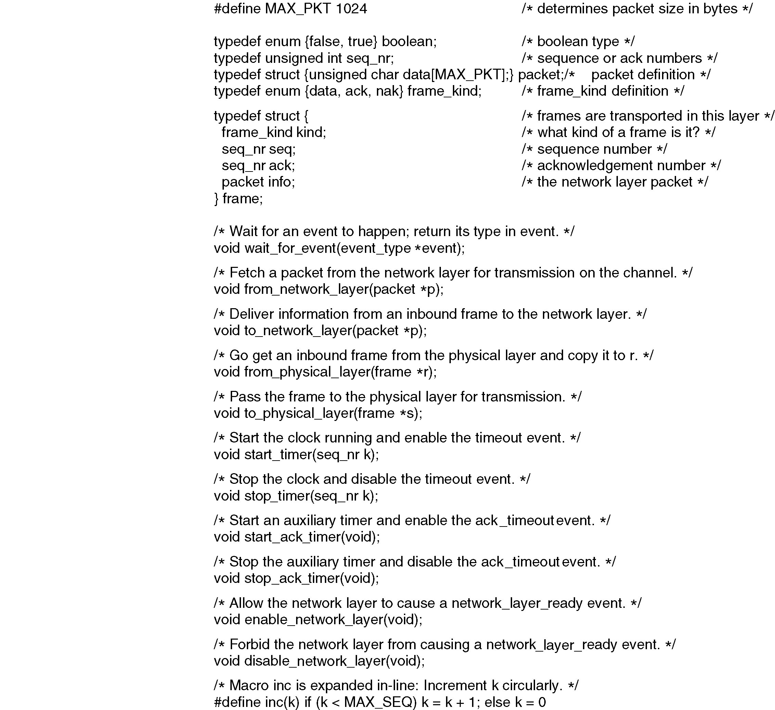
Protocol Definition in ‘C’

Slide 71
Protocol Definition in ‘C’

Slide 72
Elementary Data Link Layer Protocols
Frame consist four fields
Kind
Seq
Ack
Info
The first three contain control information
Info contain actual data
Control fields are collectively called frame header
Kind tells whether it is control frame or data frame
Seq and Ack : Sequence number and Acknowledgment
Frame seq number : in range of 0 to max_seq

Slide 73
Elementary Data Link Layer Protocols
Three types
An unrestricted simplex protocol
A simplex stop-and-wait protocol
A simplex protocol for a noisy channel

Slide 74
Unrestricted Simplex protocol
Assumptions:
Data are transmitted in one direction
Both the transmitting and receiving N/W layers are always ready
Processing time is ignored
Infinite buffer space available
No loss of frame, communication channel is never damaged
2 procedures: sender and receiver
Protocol is known as “utopia”

Slide 75
Unrestricted Simplex protocol
void sender (void) { frame s; packet buffer; while (true) { from_network_layer(&buffer); s.info = buffer; to_physical_layer(&s); } } | void receiver (void) { frame r; event_type event; while (true) { wait_for_event(&event); from_physical_layer(&r); to_network_layer(&r.info); } }

Slide 76
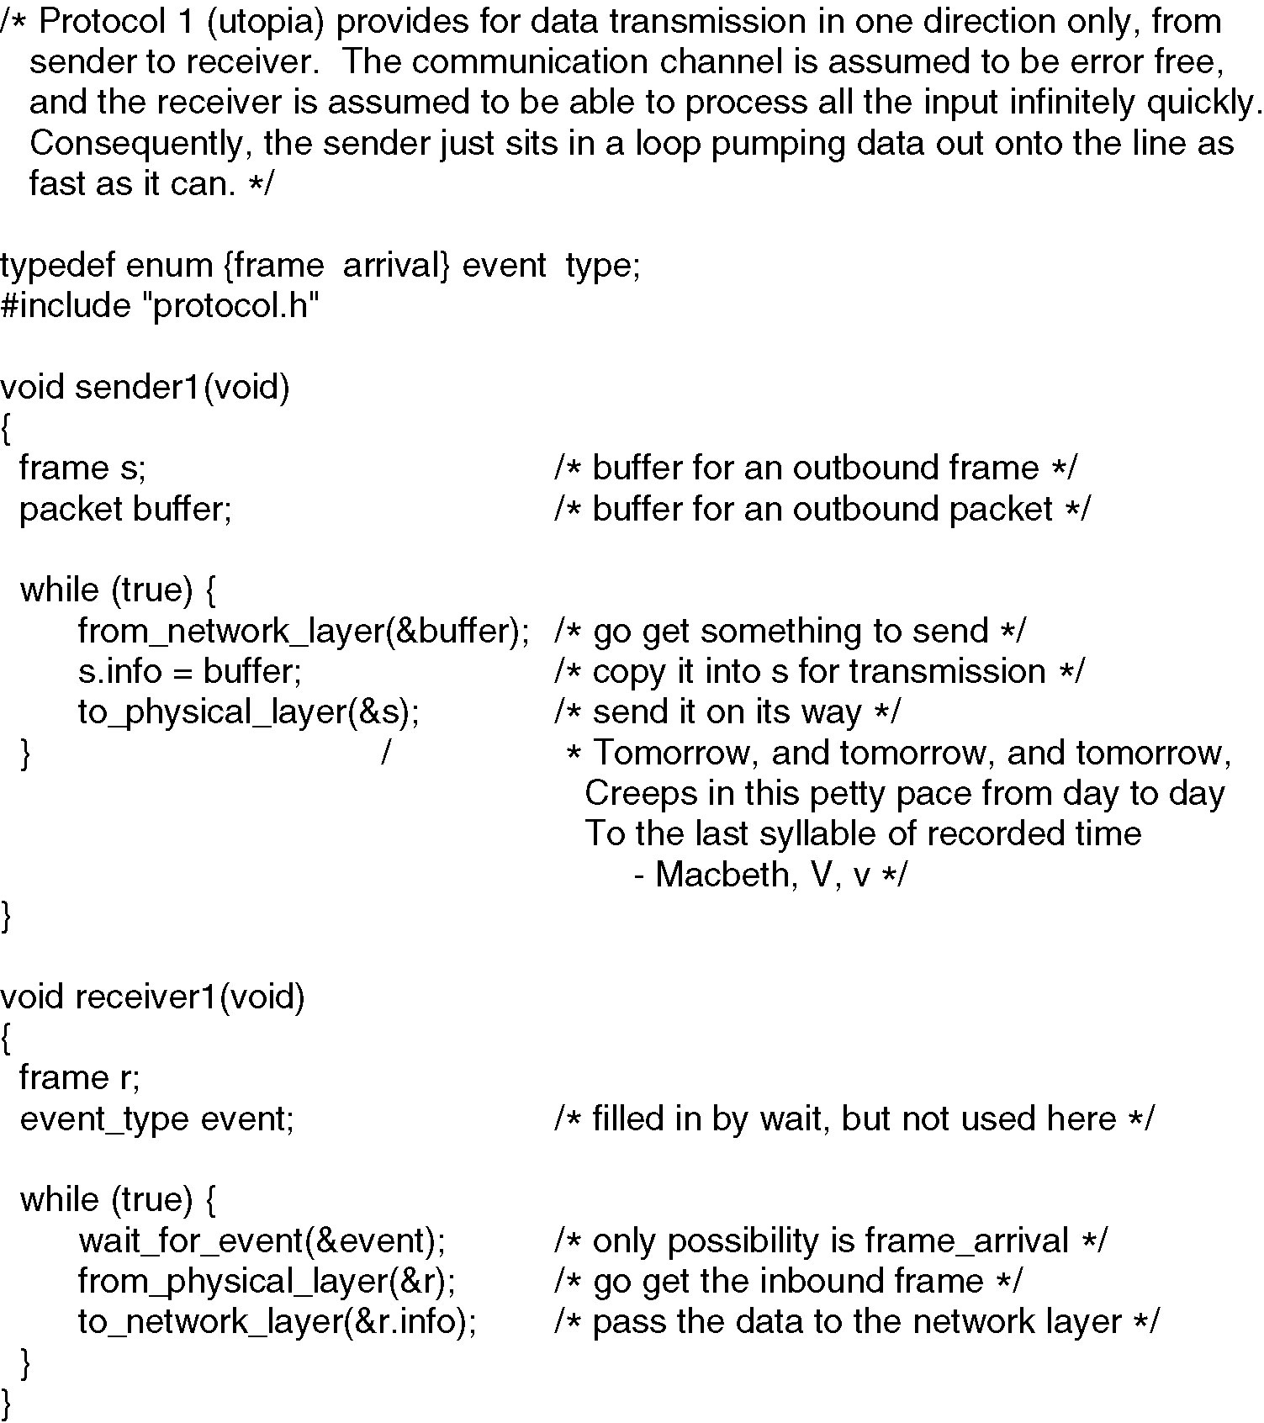
Unrestricted Simplex protocol

Slide 77
Unrestricted Simplex protocol
Protocol consist two procedure
Sender : runs in DLL of sending machine
Receiver: runs in DLL of receiving machine
No ACK or Seq Number
Only one event : frame_arrival

Slide 78
Unrestricted Simplex protocol
Sender will be in infinite loop
Loop includes three actions
Go fetch a packet from network layer
Construct frame using variable s
Send the frame on its way
Receiver waits for something to happen
Only possibility is arrival of undamaged frame
Receiver will wait using wait_for_event procedure

Slide 79
Unrestricted Simplex protocol
Advantages:
Simple protocol
Highly unrealistic
Disadvantages:
Flooding

Slide 80
A Simplex Stop and Wait protocol
Assumptions:
Communication channel is error free
Data traffic is in one direction
Receiver has only finite buffer capacity and finite processing speed
Problem Focused: Prevent the sender from flooding the receiver with data faster than receiver can handle them

Slide 81
A Simplex Stop and Wait protocol
Receiver provides feedback to sender
After passing packet to network layer, receiver will send dummy frame to sender giving permission to transmit next frame
After sending frame sender will wait for dummy frame from receiver
Protocols in which the sender sends one frame and then waits for an acknowledgement before proceeding are called stop-and-wait.

Slide 82
Unrestricted Simplex protocol
void sender (void) { frame s; packet buffer; event_type event; while (true) { from_network_layer(&buffer); s.info = buffer; to_physical_layer(&s); wait_for_event(&event); }} | void receiver (void) { frame r, s; event_type event; while (true) { wait_for_event(&event); from_physical_layer(&r); to_network_layer(&r.info); to_physical_layer(&s); } }

Slide 83
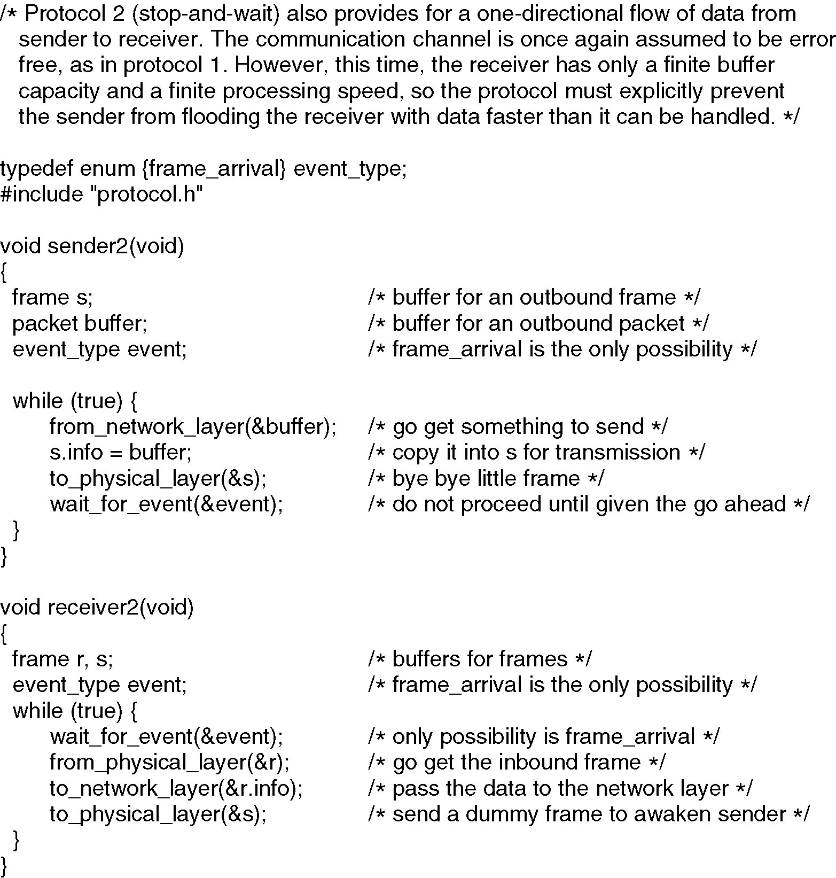
A Simplex Stop and Wait protocol

Slide 84
A Simplex Stop and Wait protocol
Advantages:
Simple reliable transmission
Disadvantages:
Sender always wait for the ack frame to send the next frame
If the ack frame gets corrupted the sender cannot perform any anymore

Slide 85
A Simplex protocol for noisy channel
Assumptions:
data transfer is only in one direction
Finite processing capacity and speed at the receiver
Errors in the data frames or ack frames are expected
Every frame has a unique sequence number
Timer is kept, if the ack is not received withing the time frame, the frame gets retransmitted

Slide 86
A Simplex protocol for noisy channel
The network layer on A gives packet 1 to its data link layer. The packet is correctly received at B and passed to the network layer on B. B sends an acknowledgement frame back to A.
The data link layer on A eventually times out. Not having received an acknowledgement, it (incorrectly) assumes that its data frame was lost or damaged and sends the frame containing packet 1 again.
The duplicate frame also arrives at the data link layer on B perfectly and is unwittingly passed to the network layer there. If A is sending a file to B, part of the file will be duplicated (i.e., the copy of the file made by B will be incorrect and the error will not have been detected). In other words, the protocol will fail.

Slide 87
A Simplex protocol for noisy channel
Problem : Some way is required for the receiver to distinguish a frame
Solution : Sequence number in the header of the frame

Slide 88
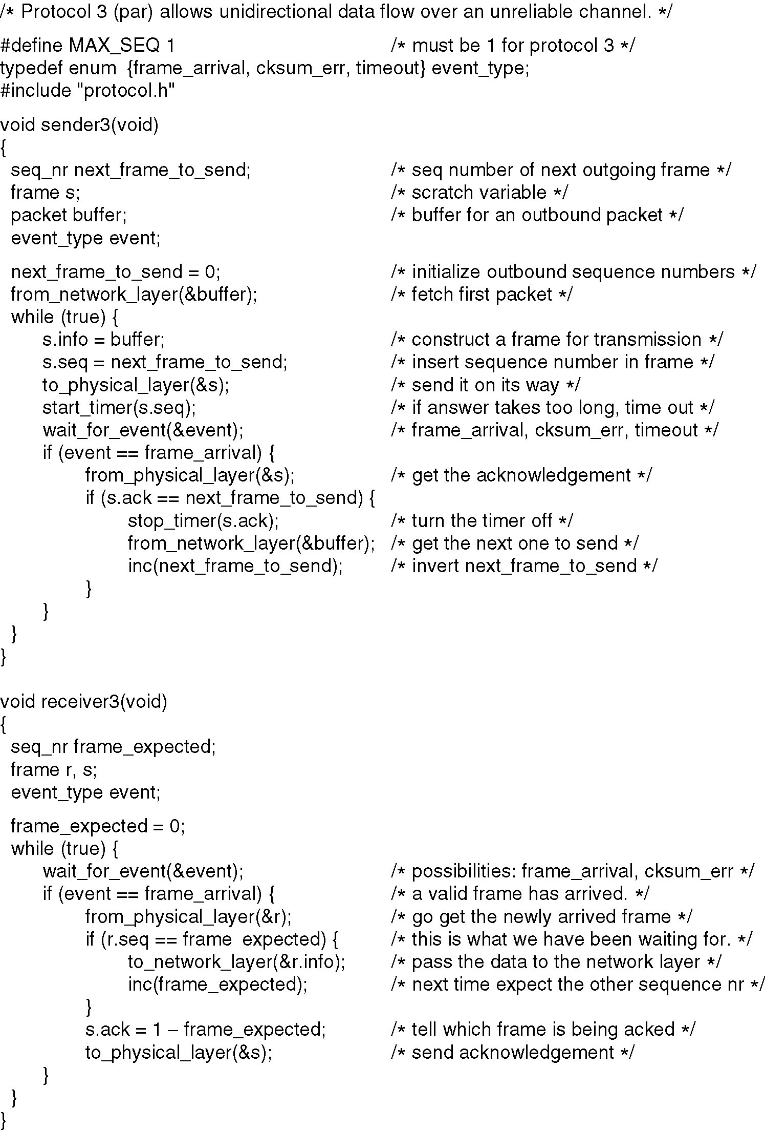
A Simplex protocol for noisy channel

Slide 90
A Simplex protocol for noisy channel
After transmitting frame sender starts the timer
Sender waits for something to happen
Three possibilities are there:
An ACK arrives undamaged
Damaged ACK arrives
Timer expires

Slide 91
A Simplex protocol for noisy channel Receiver side process
If valid ACK arrives: Sender fetch packet from network layer and put it in buffer
Advances sequence number
When a valid frame arrives at receiver : sequence number is checked
Check if it is duplicate
If not, accept it pass to network layer and ACK is generated
Duplicates and damaged frame are not passed to network layer

Slide 92
A Simplex protocol for noisy channel
Protocols in which the sender waits for a positive acknowledgement before advancing to the next data item are often called ARQ (Automatic Repeat reQuest) or PAR (Positive
Acknowledgement with Retransmission).
Advantage:
Handle lost frames by using timer
Disadvantages:
If the interval is too short, retransmissions occur
If too long, bandwidth is wasted as sender waits too long before doing a transmission

Slide 93
Sliding Window Protocols
Previous protocols : One Way transmission
Need for transmitting data in both direction
Solution : Have two separate communication channel
So two separate physical circuits each with forward channel (for data) and reverse channel (for ACK)
Reverse Channel bandwidth will be wasted.

Slide 94
Sliding Window Protocols
Solution : use same circuit for data in both direction.
Reverse channel has same capacity as forward channel
Present scenario : Sender send’s data frame and wait for ACK.
Receiver receive data frame and send ACK
Sender receiving ACK transmit next frame.
Disadvantage: Bandwidth wasted in present scenario.

Slide 95
Sliding Window Protocols
Solution :
When data frame arrives instead of immediately sending ACK receiver will wait till network layer provide some next packet
The ACK is attached with data frame
The ACK gets free ride on the next outgoing data frame.
Technique is known as piggybacking

Slide 96
Sliding Window Protocols
Advantage of Piggybacking:
Better use of channel bandwidth
fewer frames sent means fewer “frame arrival” interrupts and fewer buffers
It do not cost more than few bits

Slide 97
Sliding Window Protocols
Disadvantage of Piggybacking:
How long should the data link layer wait for a packet onto which to piggyback the ACK?
If longer wait time: sender will timeout: retransmission :duplicate frames
Solution : Decide some fixed time, if packet come within that time, piggyback ACK else send ACK separately

Slide 98
Sliding Window Protocols
Each frame in sliding window protocol will have sequence number ranging from 0 to some maximum
Sliding window protocols are bidirectional
The maximum is 2^{n} -1.
sequence number fits exactly in n bits.

Slide 99
Sliding Window Protocols
Sender maintains a set of sequence numbers corresponding to frames it is permitted to send
These frames are said to fall within the sending window
Receiver also maintains a receiving window corresponding to the set of frames it is permitted to accept.
Sender’s window and receiver’s window need not have the same lower and upper limits or even have the same size.

Slide 100
Sliding Window Protocols
Frames within sender’s window represent frames that have been sent or can be sent but are not yet acknowledged
Whenever a packet arrives from network layer, it is given the next highest sequence number and the upper edge of the window is expanded by one
When an ACK comes in lower edge is advanced by one.
In this way window continuously maintains a list of unacknowledged frames.

Slide 101
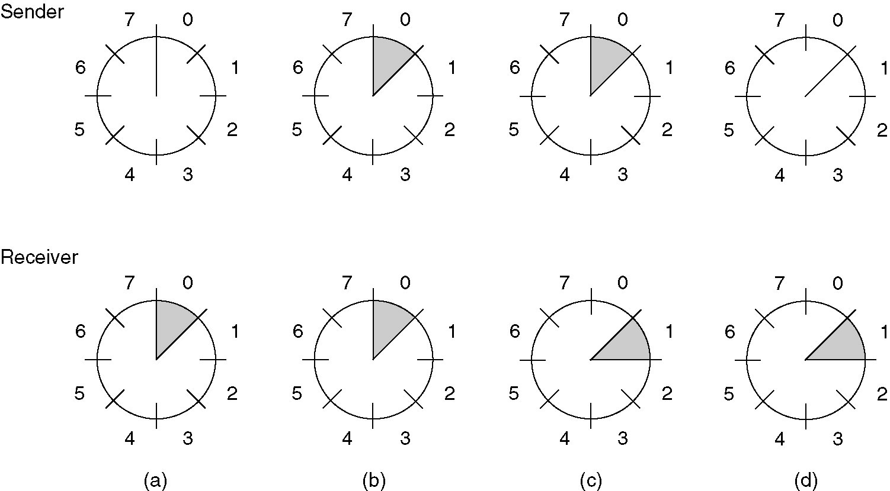
Sliding Window Protocols
A sliding window of size 1, with a 3-bit sequence number.
(a) Initially.
(b) After the first frame has been sent.
(c) After the first frame has been received.
(d) After the first acknowledgement has been received.

Slide 102
Example: HDLC
Link could be point-to-point or broadcast
Protocol:
Define the format of frames
In response to frames, action to be taken by nodes
Example: Ethernet, PPP etc

Slide 103
Example: HDLC
DLL is divided into two sub-layers: logic link control (LLC) and Media Access Control (MAC)
LLC : interface between network layer and MAC sub-layer
Responsible for:
Error detection and correction
Flow control
MAC: controls access to the physical media

Slide 104
Example: HDLC
Bit oriented protocols –
It views the frame as a collection of bits
Eg., HDLC
Byte oriented protocols-
It views frames as collection of bytes (not bits)
Examples:
PPP (point –to –point protocol)
BISYNC- Binary synchronous communication protocol by IBM

Slide 105
Example: HDLC
HDLC: High-level Data link Control
Bit –oriented protocol
The synchronous Data link control (SDLC) protocol developed by IBM
Later standardized by ISO as HDLC protocol
Forms basis for other protocols
Very important DLL protocol

Slide 106
Example: HDLC
Frame format:
Beginning and ending sequence: uses bit pattern 01111110
Header: Address and Control field
Body: payload (variable size)
CRC: error detection
Beginning sequence (8) | Header (16) | Body | CRC (16) | Ending sequence (8)

Slide 107
Example: HDLC
Types of frames:
Types of frame is determined by the control field
I-frame: Information frame
S-frame: Supervisory frame
U-frame: Un-numbered frame
I-frame | Ist bit is 0
S-frame | Ist bit is 10
U-frame | Ist bit is 11

